Slide 1
Sudoku solver using genetic algorithm
Andrei Cojocariu
Sorin-Adrian Vladescu
​
E.T.S. de Ingeniería Informática,
Universidad de Málaga
​

Slide 2

Project requirements
Solve Sudoku puzzles using the genetic algorithm. Sudoku is a puzzle of 81 squares where each row and each column of the puzzle contains the digits 1 to 9, as does every smaller 3 x 3 grid. Therefore, the task is to find suitable numbers for the blank squares that satisfy the constraints.

Slide 3



Development stages
Import QQWing library
Implementation of genetic algorithm class
Implementation of main class
Helps generate new sudoku puzzles with scalable difficulty.
Implements methods such as:
-generatePopulation
-fitnessFunction
-mutationFunction
-reproduceFunction
-weightsFunction
Brings together the modules of the system

Slide 4
Code implementation

Slide 5
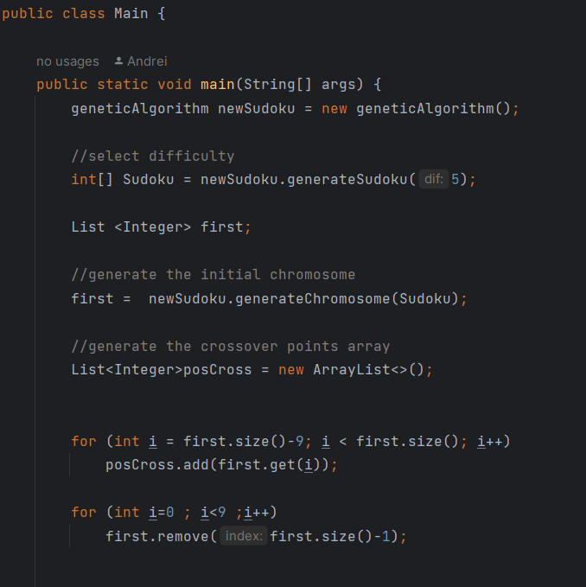
Main class
We start by creating a new sudoku game using .generateSudoku (select difficulty), followed by the initial chromosome and an array that contain the positions of the crossover points.
Fig.1

Slide 6
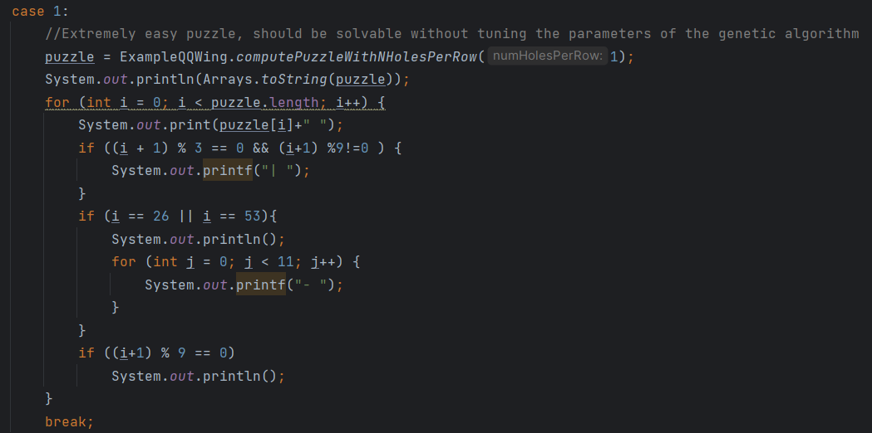
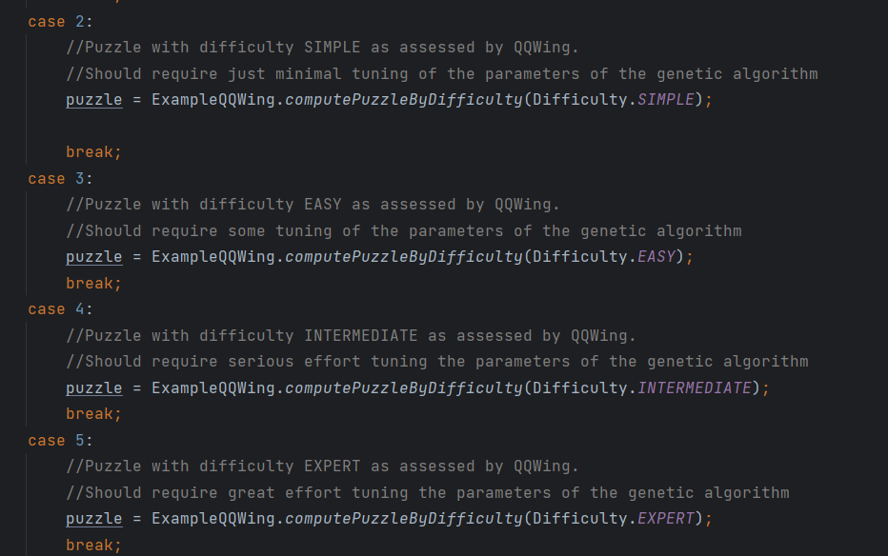
Generate sudoku puzzle
We can choose the difficulty of the game (1-5) or by stating the number of empty cells (holes) you want in each row (1 - 9).
Difficulties selection: 1 – Extremely Easy
2 – Simple
3 – Easy
4 – Intermediate
5 - Expert
Fig.2
Fig.3

Slide 7
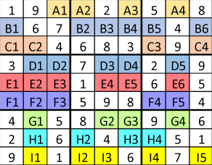
First chromosome and possible crossover points
Fig.4

Slide 8
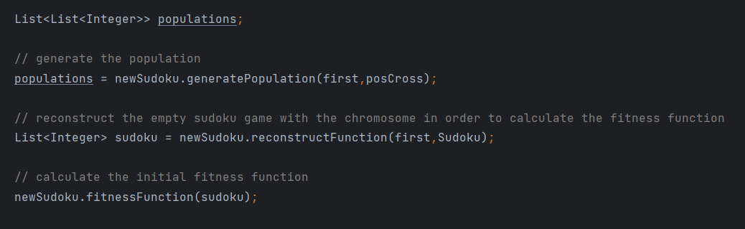
Fig.5
We create the initial population by creating different individuals using variations of the first chromosome and calculate the fitness value of each individual (ensuring that each individual respects the constraints and the rules of the game).

Slide 9
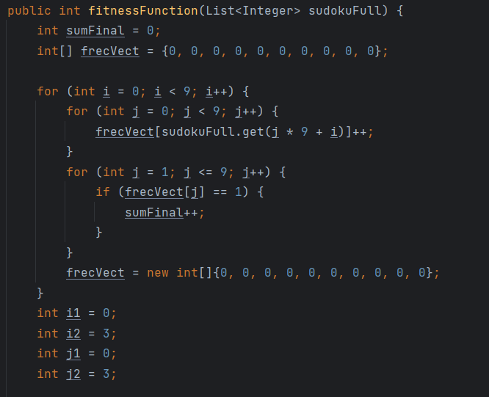
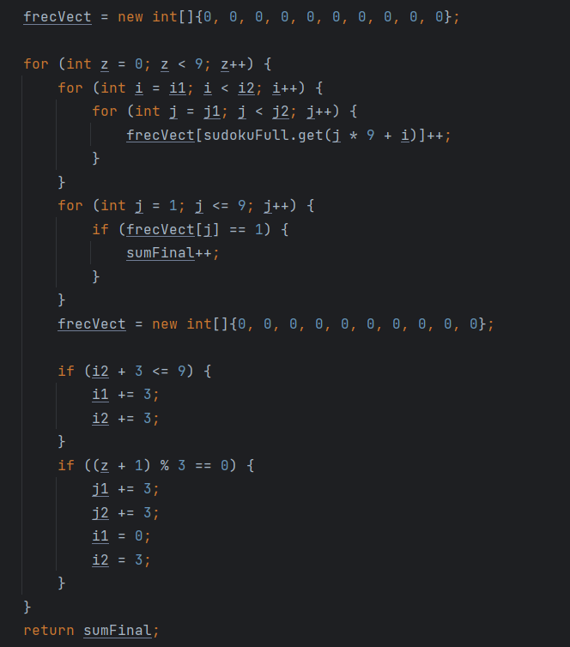
Fitness function
Fig.6
Fig.7

Slide 10
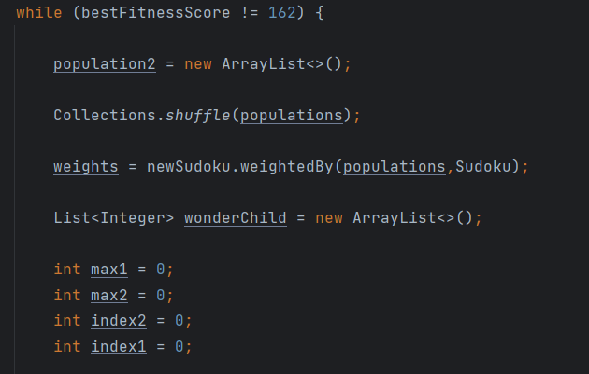
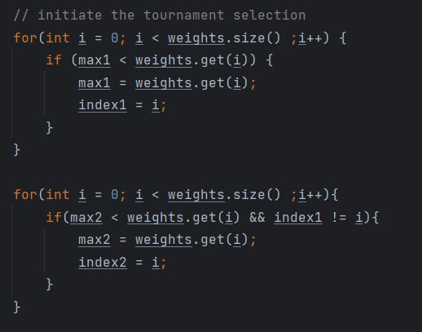
Reproduction of chromosomes
Fig.8
Fig.9
Steps in the code:
Initial population -> Tournament Selection -> Crossover -> Child -> Mutation -> New Population

Slide 11
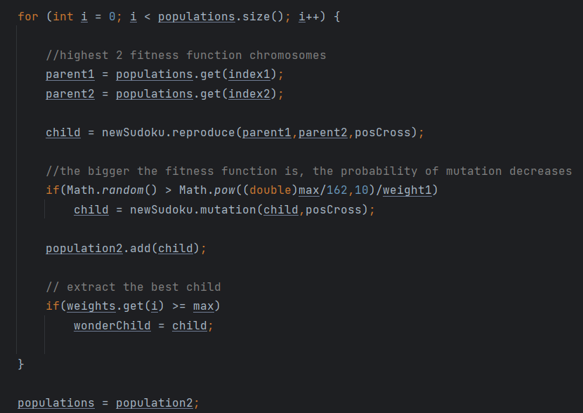
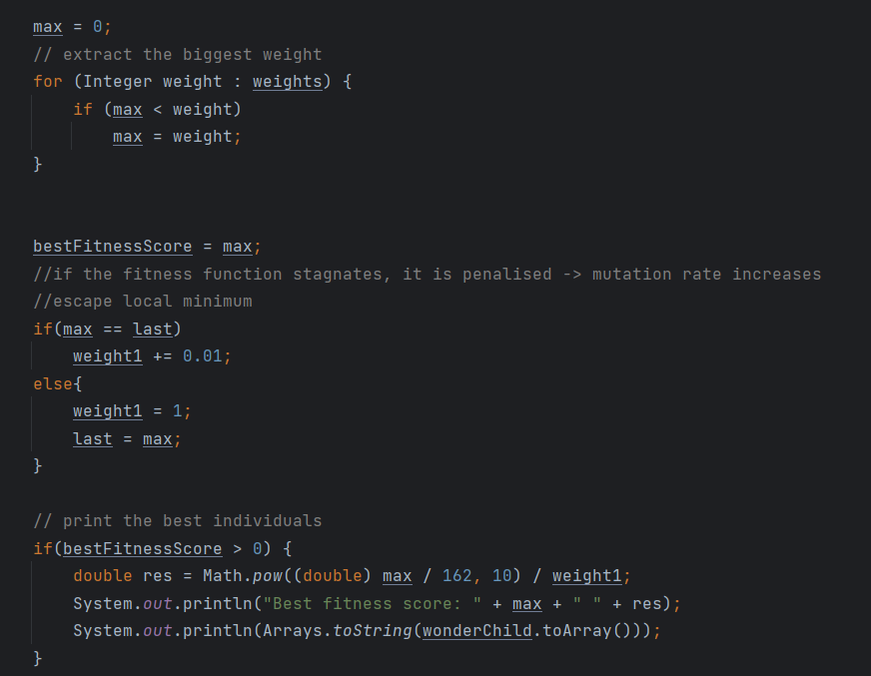
Fig.10
Fig.11

Slide 12
Mean Fitness vs best individual fitness

Slide 13
Performance of the genetic algorithm
Number of holes/row | Population | Number of iterations
2 | 10 000 | 1
2 | 100 000 | 1
2 | 1 000 000 | 1
3 | 10 000 | 3.9
3 | 100 000 | 2.8
3 | 1 000 000 | 2
4 | 10 000 | 74.9
4 | 100 000 | 32.4
4 | 1 000 000 | 6.9

Slide 14
Performance of the genetic algorithm
As the number of empty cells grows on each row, the number of iterations will grow
Exponentially (^9 for each new cell added/row) as well as the time spent to perform the
calculus.

Slide 15
Summary
The genetic algorithm implemented in the sudoku solver is able to detect viable solutions for every difficulty stage, but the population number affects the number of iterations it takes to find them.​

Slide 16
Thank you!
Cojocariu Andrei
Sorin-Adrian Vladescu
​
E.T.S. de Ingeniería Informática,
Universidad de Málaga
​

